Slide 1
Machine Learning DSECL ZG565
Dr. Monali Mavani

Slide 2
Session Content
Decision Theory
Probabilistic Discriminative and Generative Classifiers
Linear Regression – Geometric Approach
Gradient Descent Optimization
Logistic regression
Gradient Descent Optimization
Difference between Naïve Bayes Classifier and Logistic Regression

Slide 3
Decision Theory

Slide 4
Decision Theory
Suppose x is an input vector together with a corresponding vector t of target variables
Goal: predict t given a new value for x.
The joint probability distribution p(x, t) provides a complete summary of the uncertainty associated with these variables.
Determination of p(x, t) from a set of training data is called inference and is a difficult problem.

Slide 5
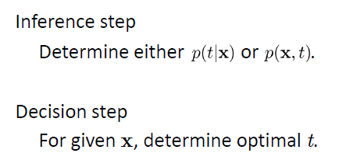
Decision Theory

Slide 6

Example : Medical diagnosis problem
Input: X-ray image of a patient
Input vector x is the set of pixel intensities in the image
Output: Presence of cancer = Class C1,
Absence of cancer, = Class C2.
Choose t to be a binary variable such that
t =0 corresponds to C1 and t =1 corresponds to C2.
We are interested in the probabilities of the two classes given the image, which are given by p(C_{k}|x).
Using Bayes’ theorem,

Slide 7
Minimum Misclassification Rate
Divide the input space into regions Rk called decision regions, one for each class, such that all points in Rk are assigned to class Ck
Boundaries between decision regions are called decision boundaries or decision surfaces
A mistake occurs when an input vector belonging to class C1 is assigned to class C2 or vice versa.

Slide 8
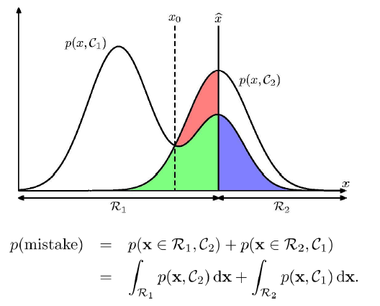
Minimum Misclassification Rate

Slide 9
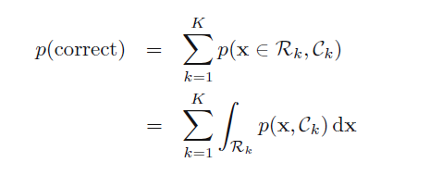
Minimum Misclassification Rate

Slide 10
Inference and Decision
We have broken the classification problem down into two separate stages, the inference stage in which we use training data to learn a model for p(C_{k}|x), and the subsequent decision stage in which we use these posterior probabilities to make optimal class assignments.
An alternative possibility would be to solve both problems together and simply learn a function that maps inputs x directly into decisions. Such a function is called a discriminant function.
Three distinct approaches to solving decision problems

Slide 11

Discriminant Functions
A discriminant is a function that takes an input vector x and assigns it to one of K classes, denoted C_{k}.
We restrict our attention to linear discriminants where the decision surfaces are hyperplanes.
The simplest representation of a linear discriminant function is obtained by taking a linear function of the input vector so that

Slide 12

Three distinct approaches to solving decision problems
Solve the inference problem of determining the class-conditional densities p(x|Ck) for each class Ck individually. Also separately infer the prior class probabilities p(Ck). Then use Bayes’ theorem in the form p(Ck|x) = p(x|Ck)p(Ck) / p(x) to find the posterior class probabilities p(Ck|x). Approaches that explicitly or implicitly model the distribution of inputs as well as outputs are known as generative models.
Solve the inference problem of determining the posterior class probabilities p(Ck|x), and then subsequently use decision theory to assign each new x to one of the classes. Approaches that model the posterior probabilities directly are called deterministic or discriminative models.
Find a function f(x), called a discriminant function, which maps each input x directly onto a class label. In this case, probability plays no role.
BITS Pilani, Deemed to be University under Section 3 of UGC Act, 1956

Slide 13
Generative vs. Discriminative Classifiers
Training classifiers involves estimating f: X → Y, or P(Y|X)
Generative classifiers (e.g., Naïve Bayes)
Assume some functional form for P(X|Y), P(X)
Estimate parameters of P(X|Y), P(X) directly from training data
Estimates not only probability of labels but also the features
Once model is fit, can be used to generate data
Use Bayes rule to calculate P(Y|X= x_{i})
Often works worse, particularly when assumptions are violated
Discriminative classifiers (e.g., Logistic regression)
Assume some functional form for P(Y|X)
Estimate parameters of P(Y|X) directly from training data
Models that try to learn mappings directly from feature space to the labels are also discriminative, e.g., perceptron, SVMs

Slide 14
Probabilistic Generative Model versus Probabilistic Discriminative Model
Generative:
Discriminative:
x₂
x₂
Decision Boundary
x₁
x₁

Slide 15
Naive Bayes and logistic regression: two different modelling paradigms
Spam classification problem
First Strategy: discriminative (e.g., logistic regression)
Use training set to find a decision boundary in the feature space that separates spam and non-spam emails
Given a test point, predict its label based on which side of the boundary it is on.
Second Strategy: generative (e.g., naive bayes)
Look at spam emails and build a model of what they look like.
Similarly, build a model of what non-spam emails look like.
To classify a new email, match it against both the spam and non-spam models to see which is the better fit.

Slide 16
Probabilistic Generative Model versus Probabilistic Discriminative Model
Generative | Discriminative
Ex: Naïve Bayes | Ex: Logistic Regression
Estimate $P(Y)$ and $P(X|Y)$ | Finds class label directly $P(Y|X)$
Prediction $$\hat{y}={argmax}_{y} P\left(Y=y\right)P(X=x|Y=y)$$ | Prediction $$\hat{y}=P(Y=y|X=x)$$

Slide 17
Linear Regression

Slide 18
Linear Regression
Wish to learn f : X → Y , where Y is real, given {<x¹,y¹>…<x^{n},y^{n}>}
Geometric Approach
Least squares function fitting given {<x¹,y¹>…<x^{n},y^{n}>}
Bayesian Approach
Choose some parameterized form for P(Y|X; θ)
( θ is the vector of parameters)
Derive learning algorithm as MCLE estimate for θ

Slide 19
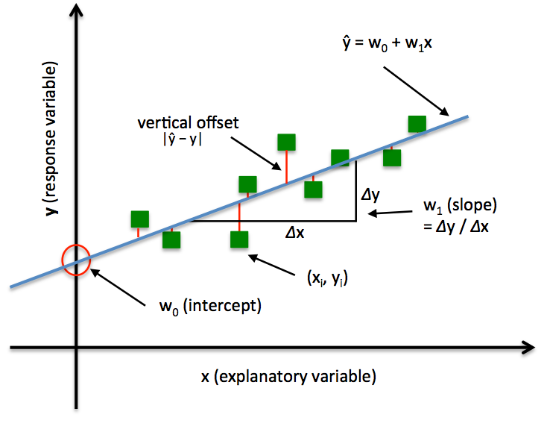
Geometric Approach
For each input observation x^{(i)}, a vector of features [x₁, x₂, …,x_{n}].
j^{th} feature of i^{th} training example: x_{j} ^{(i)}

Slide 20
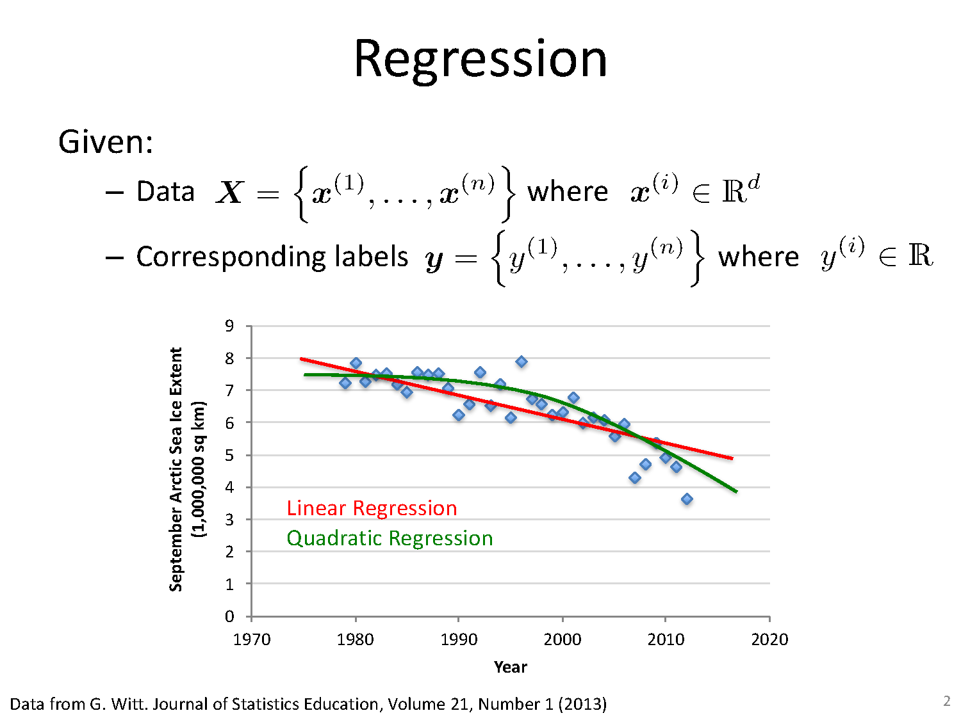
Geometric Approach

Slide 21
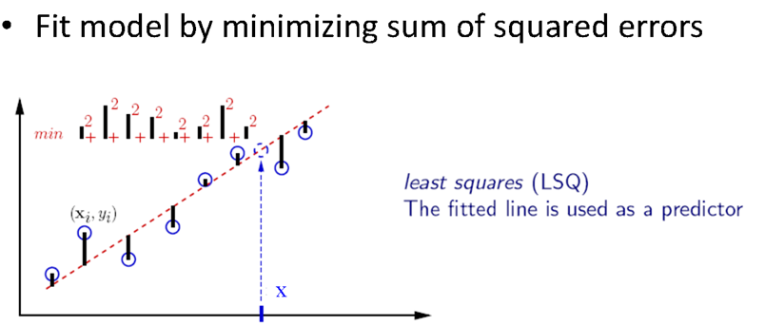
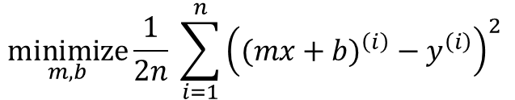
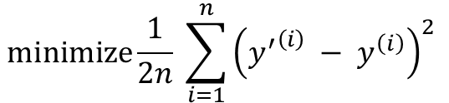
Learning a Line via Minimizing MSE
How to learn a line of equation y’ = mx + b given a labelled dataset? : By minimizing mean squared error
$$\underset{}{minimize}{\frac{1}{2n} \sum_{i=1}^{n}{{\left({y^{′}}^{\left(i\right)} − y^{\left(i\right)}\right)}^{2} }}$$
≣
$$\underset{m, b}{minimize}{\frac{1}{2n} \sum_{i=1}^{n}{{\left({(mx+b)}^{\left(i\right)} − y^{\left(i\right)}\right)}^{2} }}$$
Slide Credit : Prof. Mohammad Hammoud

Slide 22
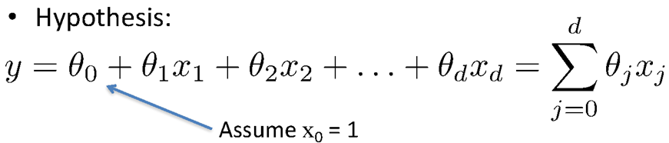
Linear Regression – Hypothesis function

Slide 23

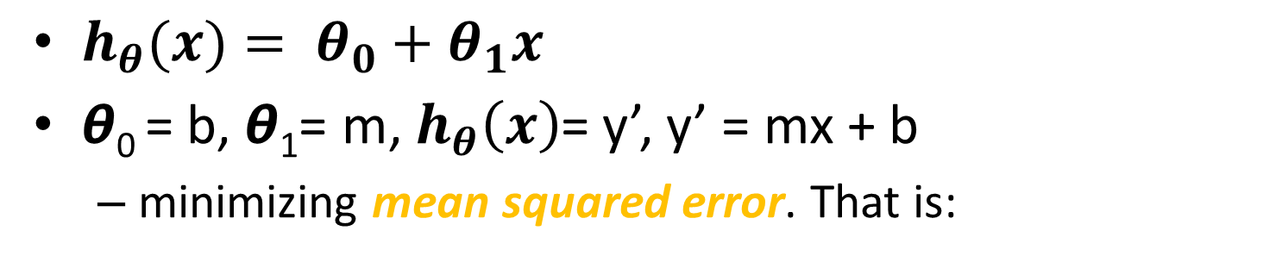
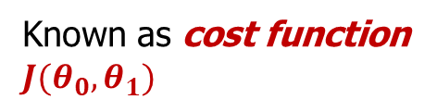
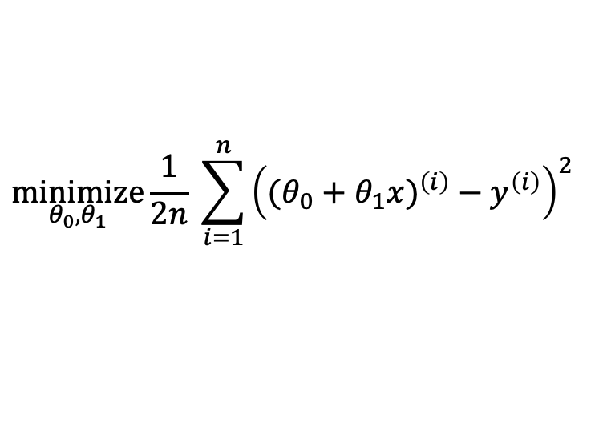
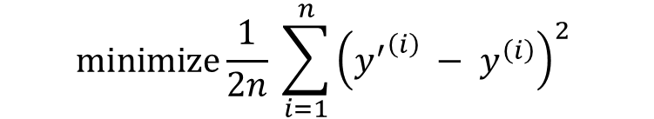

Learning a Linear Regression Model via Minimizing a Cost Function
$h_{θ}(x)= θ_{0}+θ_{1}x$
𝞱₀ = b, 𝞱₁= m, $h_{θ}\left(x\right)$= y’, y’ = mx + b
minimizing mean squared error. That is:
$$\underset{}{minimize}{\frac{1}{2n} \sum_{i=1}^{n}{{\left({y^{′}}^{\left(i\right)} − y^{\left(i\right)}\right)}^{2} }}$$
This problem is referred to as an optimization problem with the objective of:
≣
$$\underset{θ_{0},θ_{1}}{minimize}{\frac{1}{2n} \sum_{i=1}^{n}{{\left({(θ_{0}+θ_{1}x)}^{\left(i\right)} − y^{\left(i\right)}\right)}^{2} }}$$
$$\underset{θ_{0},θ_{1}}{minimizing}{J(θ_{0},θ_{1}) }$$
≣
Known as cost function
$J(θ_{0},θ_{1})$
$$\underset{θ_{0},θ_{1}}{minimize}{J(θ_{0},θ_{1}) }$$

Slide 24
Intuition Behind cost function

Slide 25
Logistic Regression

Slide 26
Linear Models for Classification
In the most common scenario
the classes are taken to be disjoint
so that each input is assigned to one and only one class
The input space is thereby divided into decision regions whose boundaries are called decision boundaries or decision surfaces
We consider linear models for classification
by which we mean that the decision surfaces are linear functions of the input vector x
Hence are defined by (D − 1)-dimensional hyperplanes within the D-dimensional input space

Slide 27
Two classes classification
In two class classification, an input vector x is assigned to class C₁ if y(x) >= 0 and to class C₂ otherwise
The corresponding decision boundary is therefore defined by the relation y(x) = 0

Slide 28
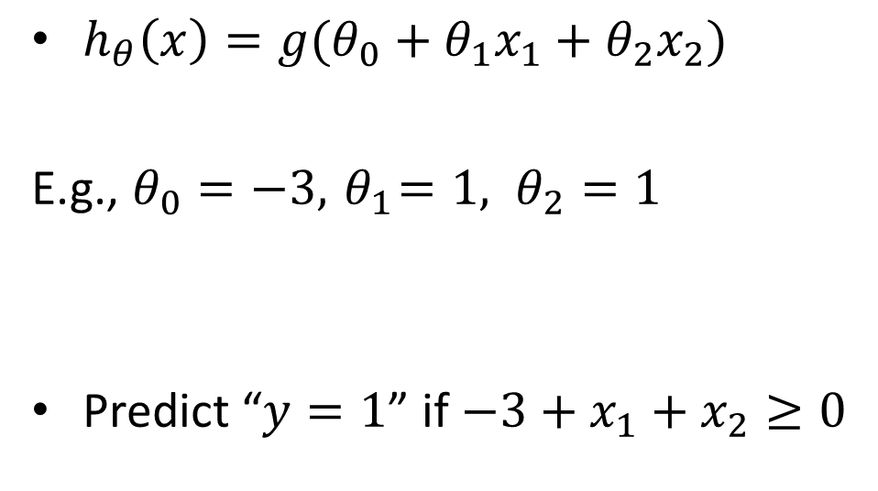
Decision boundary
$h_{θ}\left(x\right)=g(θ_{0}+θ_{1}x_{1}+θ_{2}x_{2})$
E.g., $θ_{0}=−3, { θ}_{1}=1, θ_{2}=1$
Predict “$y=1$” if $−3+x_{1}+x_{2}≥0$
Age
Tumor Size

Slide 29
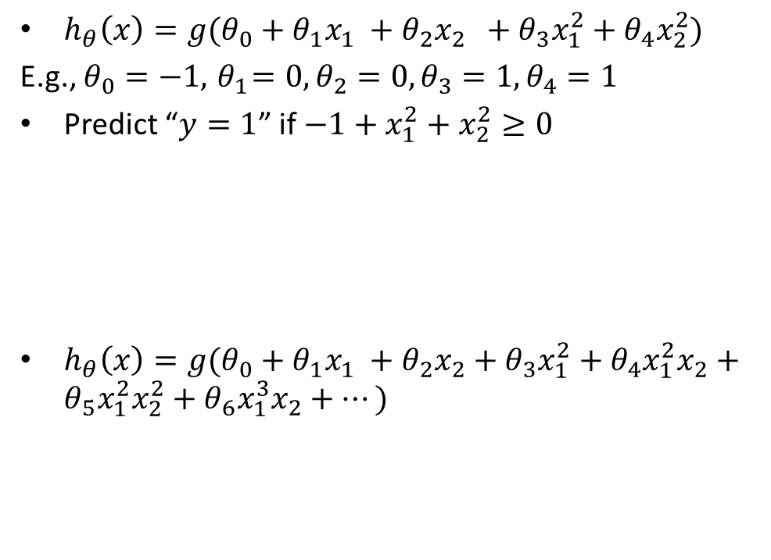
$h_{θ}\left(x\right)=g(θ_{0}+θ_{1}x_{1} +θ_{2}x_{2}$ $+$ $θ_{3}x_{1}^{2}+θ_{4}x_{2}^{2})$
E.g., $θ_{0}=−1, { θ}_{1}=0, θ_{2}=0,θ_{3}=1, θ_{4}=1$
Predict “$y=1$” if $−1+x_{1}^{2}+x_{2}^{2}≥0$
$h_{θ}\left(x\right)=g(θ_{0}+θ_{1}x_{1} +θ_{2}x_{2}+$ $θ_{3}x_{1}^{2}+θ_{4}x_{1}^{2}x_{2}+θ_{5}x_{1}^{2}x_{2}^{2}+θ_{6}x_{1}^{3}x_{2}+⋯)$

Slide 30
Logistic Regression vs Naïve Bayes
Idea:
Naïve Bayes allows computing P(Y|X) by learning P(Y) and P(X|Y)
Why not learn P(Y|X) directly?

Slide 31
Linear Regression versus logistic regression
Linear Regression could help us predict the student’s test score on a scale of 0 - 100. Linear regression predictions are continuous (numbers in a range).
Logistic Regression could help use predict whether the student passed or failed. Logistic regression predictions are discrete (only specific values or categories are allowed). We can also view probability scores underlying the model’s classifications.

Slide 32
Components
A feature representation of the input.
For each input observation x^{(i)}, a vector of features [x₁, x₂, …,x_{n}].
j^{th} feature of i^{th} training example: x_{j} ^{(i)}
A classification/hypothesis function that computes y-hat, the estimated class, via p(y|x).
An objective function for learning, usually involving minimizing error on training examples : cross-entropy loss function
An algorithm for optimizing the objective function: stochastic gradient descent algorithm.

Slide 33

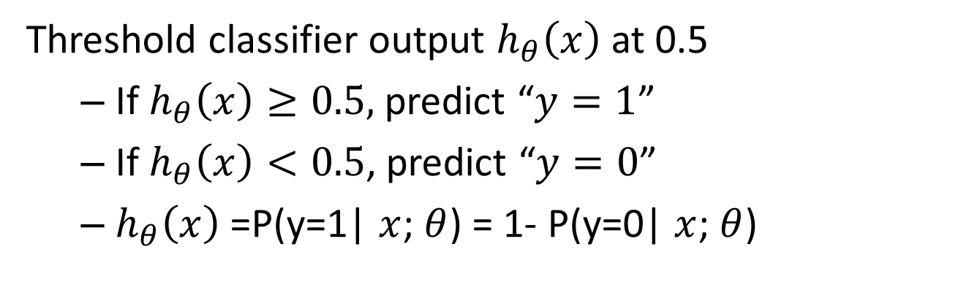
1 (Yes)
Malignant?
0 (No)
Tumor Size
$$h_{θ}\left(x\right)=θ^{⊤}x$$
Threshold classifier output $h_{θ}\left(x\right)$ at 0.5
If $h_{θ}\left(x\right)≥0.5,$ predict “$y=1$”
If $h_{θ}\left(x\right)<0.5$, predict “$y=0$”
$h_{θ}\left(x\right)$ =P(y=1| $x$; $θ$) = 1- P(y=0| $x$; $θ$)

Slide 34
Sigmoid/Logistic Function
‘sigmoid’ means S-shaped.
A ‘squashing function’ because it maps the whole real axis into a finite interval.
g(z) = 1/(1+ e^{− z} )
The inverse of the logistic sigmoid is and is known as the logit function.

Slide 35
Properties : Sigmoid/Logistic Function
Takes a real number and outputs the number in the interval [0,1] ← thus, interpretable as probability
Monotonically increasing thus, usable to derive classification rules
σ(a) > 0.5, positive (classify as ’1’)
σ(a) < 0.5, negative (classify as ’0’)
Nice computational properties Derivative is in a simple form
It satisfies the following symmetry property

Slide 36
Sigmoid Decision Boundary
σ(a) is nonlinear,
however, the decision boundary is determined by σ(b + w^{T}x ) = 0.5 ⇒ b + w^{T}x = 0
which is a linear function in x

Slide 37
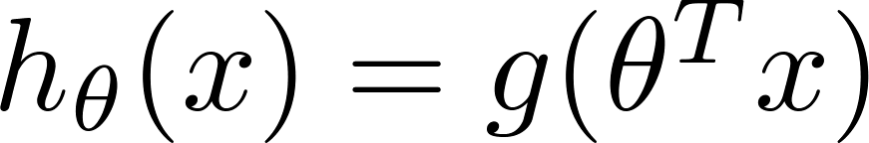
Logistic regression
‘That framework is called logistic regression
Logistic: A special mathematical sigmoid function it uses
Regression: Combines a weight vector with observations to create an answer

Slide 38
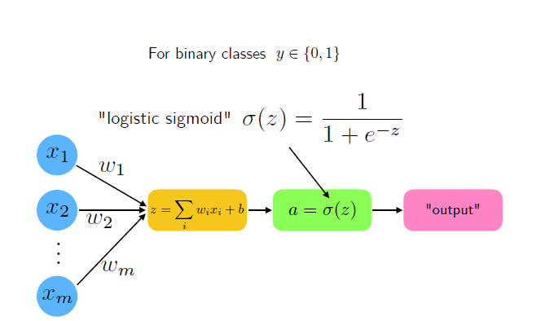

Slide 39
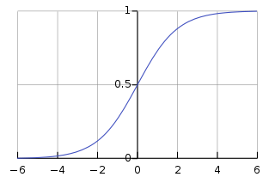
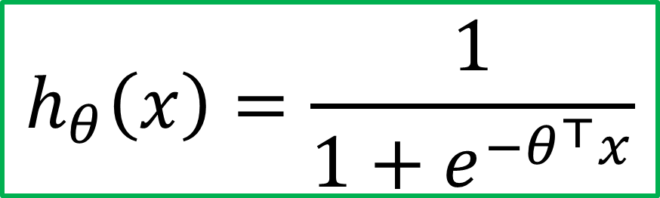



Logistic regression model
Hypothesis representation
Want ${0≤h}_{θ}\left(x\right)≤1$
$h_{θ}\left(x\right)=g\left(θ^{⊤}x\right),$ where $g\left(z\right)=\frac{1}{1+e^{−z}}$
$$h_{θ}\left(x\right)=\frac{1}{1+e^{−θ^{⊤}x}}$$
$$g(z)$$
$$z$$

Slide 40
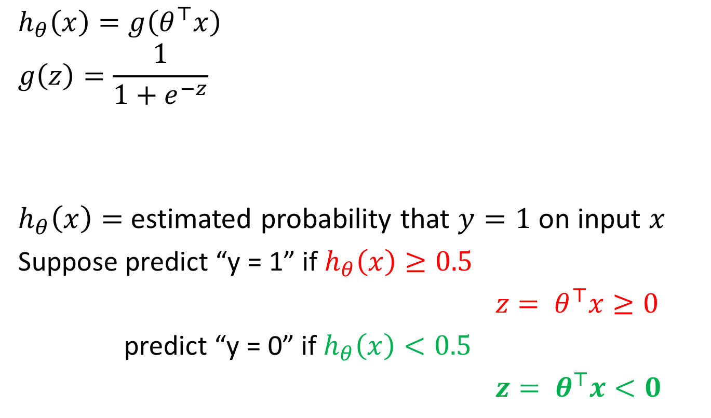


Interpretation of hypothesis output
$$h_{θ}\left(x\right)=g\left(θ^{⊤}x\right)$$
$$g\left(z\right)=\frac{1}{1+e^{−z}}$$
$h_{θ}\left(x\right)=$ estimated probability that $y=1$ on input $x$
Suppose predict “y = 1” if $h_{θ}\left(x\right)≥0.5$
${z= θ}^{⊤}x≥0$
predict “y = 0” if $h_{θ}\left(x\right)<0.5$
${z= θ}^{⊤}x<0$
$$g(z)$$
$$z=θ^{⊤}x$$

Slide 41
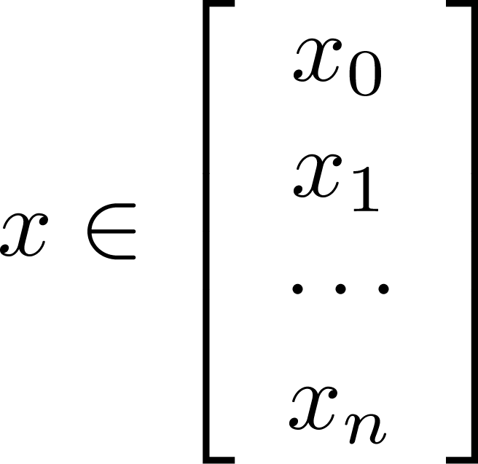
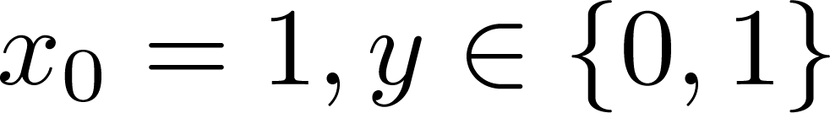
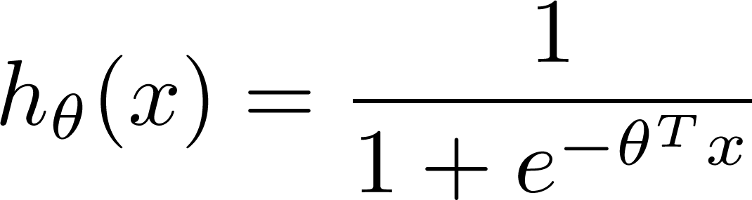

Learning model parameters
Training set:
m examples
How to choose parameters (feature weights) ?

Slide 42
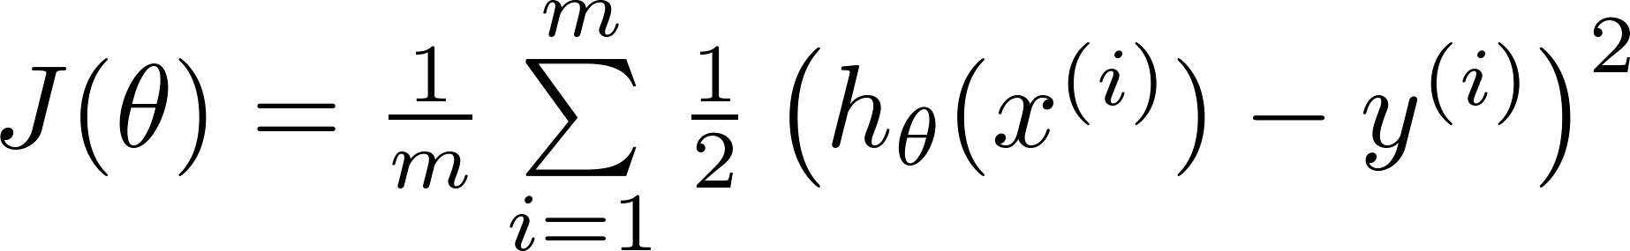

MSE Cost Function
Linear regression:
“non-convex”
“convex”

Slide 43
Error (Cost) Function
Our prediction function is non-linear (due to sigmoid transform)
Squaring this prediction as we do in MSE results
in a non-convex function with many local minima.
If our cost function has many local minimums,
gradient descent may not find the optimal global minimum.
So instead of Mean Squared Error, we use a error/ cost function called Cross-Entropy, also known as Log Loss.

Slide 44
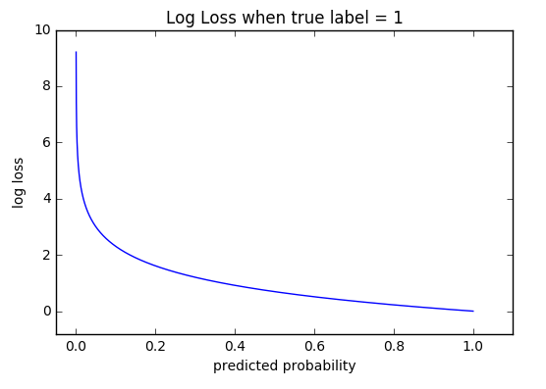
Cross Entropy
Uses conditional maximum likelihood estimation. Prefers the correct class labels of the training examples to be more likely.
we choose the parameters w and b that maximize the log probability of the true y labels known as negative log likelihood loss or cross-entropy loss
Cross-entropy loss increases as the predicted probability diverges from the actual label.
So predicting a probability of .012 when the actual observation label is 1 would be bad and result in a high loss value.
A perfect model would have a log loss of 0.

Slide 45
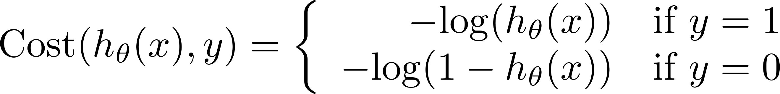
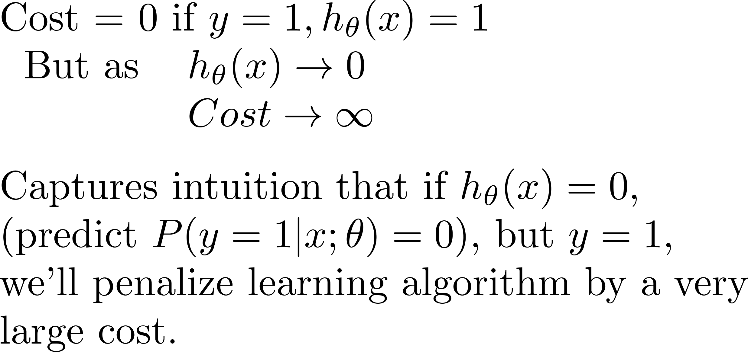
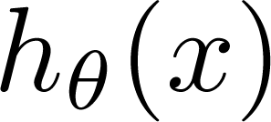
Logistic regression cost function (cross entropy)
Cross-entropy loss can be divided into two separate cost functions: one for y=1 and one for y=0.
If y = 1
Cost
0
1

Slide 46
Logistic regression cost function
If y = 0
Cost=0; If y=0 and h_{Ꝋ}(x)=0
Cost
0
1

Slide 47
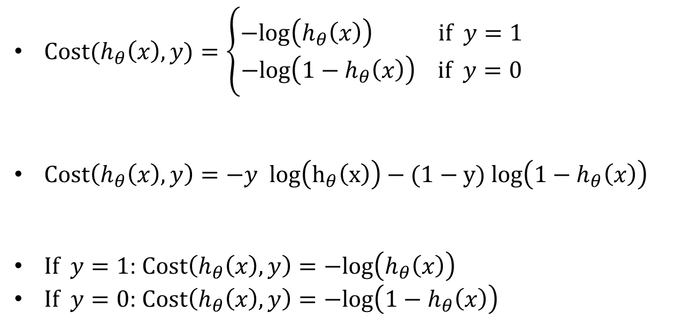
Logistic regression cost function
$Cost(h_{θ}\left(x\right),y)=\left\{\begin{aligned}−log\left(h_{θ}\left(x\right)\right) if y=1 \\ −log\left({1−h}_{θ}\left(x\right)\right) if y=0\end{aligned}\right.$
$Cost\left(h_{θ}\left(x\right),y\right)=−y log\left(h_{θ}\left(x\right)\right)−(1−y)$ $log\left({1−h}_{θ}\left(x\right)\right)$
$If y=1$: $Cost\left(h_{θ}\left(x\right),y\right)=−log\left(h_{θ}\left(x\right)\right)$
$If y=0$: $Cost\left(h_{θ}\left(x\right),y\right)=−log\left({1−h}_{θ}\left(x\right)\right)$

Slide 48
Derivation for loss function

Slide 49
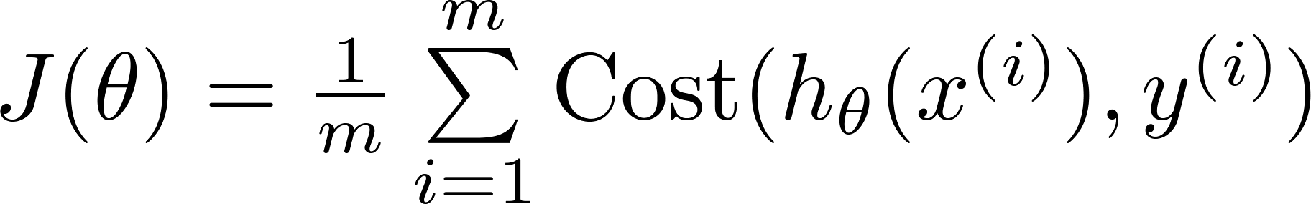

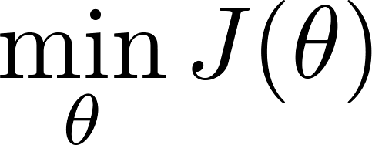

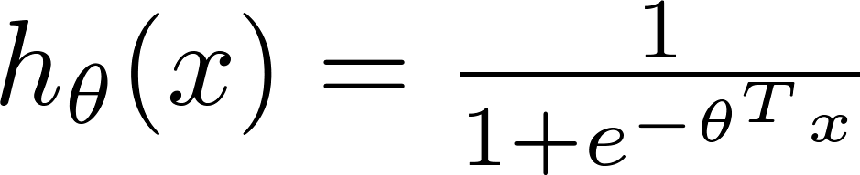
Cost function for m training examples
$Cost\left(h_{θ}\left(x\right),y\right)=−y log\left(h_{θ}\left(x\right)\right)−(1−y)$ $log\left({1−h}_{θ}\left(x\right)\right)$
To fit parameters : Apply Gradient Descent Algorithm
To make a prediction given new :
Output

Slide 50
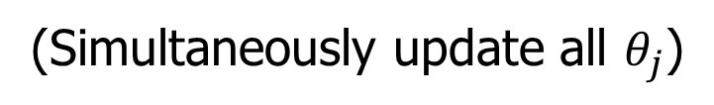
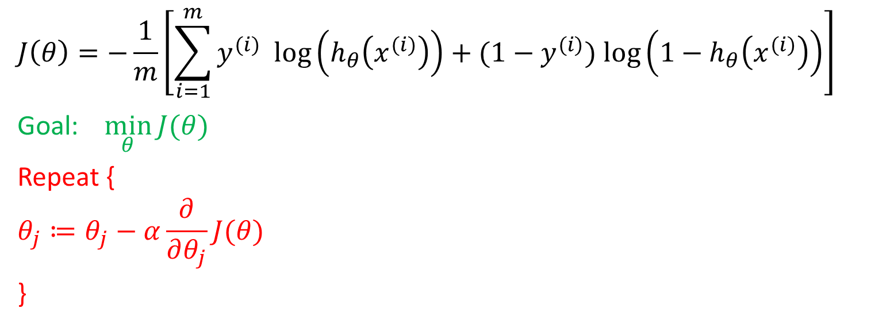
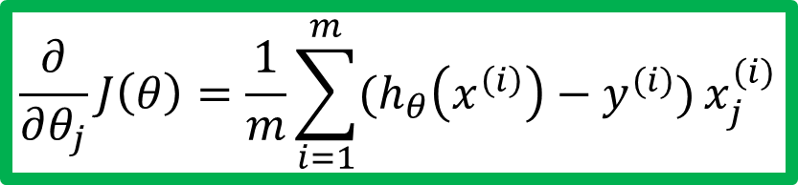
Gradient descent
$$J\left(θ\right)=−\frac{1}{m}\left[\sum_{i=1}^{m}{y^{(i)} log\left(h_{θ}\left(x^{(i)}\right)\right)+(1−y^{(i)}) log\left({1−h}_{θ}\left(x^{(i)}\right)\right)}\right]$$
Goal: $\min_{θ}{J(θ)}$
Repeat {
$$θ_{j}≔θ_{j}−α\frac{∂}{∂θ_{j}}J(θ)$$
}
Good news: Convex function!
Bad news: No analytical solution
(Simultaneously update all $θ_{j}$)
$$\frac{∂}{∂θ_{j}}J\left(θ\right)=\frac{1}{m}\sum_{i=1}^{m}{(h_{θ}\left(x^{\left(i\right)}\right)−y^{(i)})}x_{j}^{(i)}$$

Slide 51
Intuition behind Gradient descent

Slide 52
Gradient Descent Example

Slide 53
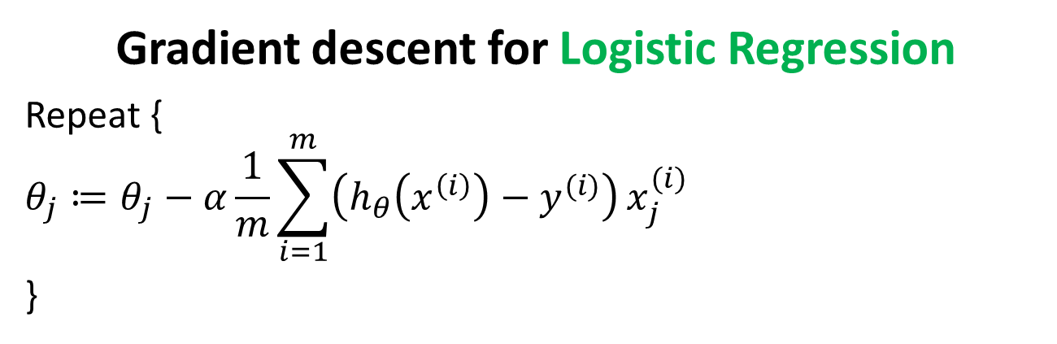
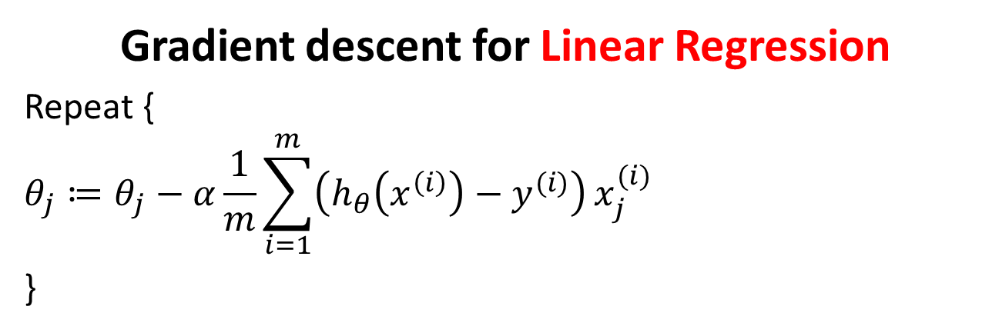
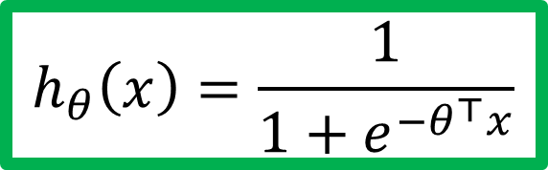
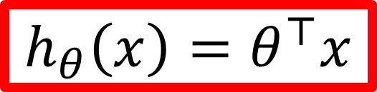
Gradient descent for Linear Regression
Repeat {
$$θ_{j}≔θ_{j}−α\frac{1}{m}\sum_{i=1}^{m}{\left(h_{θ}\left(x^{\left(i\right)}\right)−y^{(i)}\right)}x_{j}^{(i)}$$
}
$$h_{θ}\left(x\right)=θ^{⊤}x$$
Gradient descent for Logistic Regression
Repeat {
$$θ_{j}≔θ_{j}−α\frac{1}{m}\sum_{i=1}^{m}{\left(h_{θ}\left(x^{\left(i\right)}\right)−y^{(i)}\right)}x_{j}^{(i)}$$
}
$$h_{θ}\left(x\right)=\frac{1}{1+e^{−θ^{⊤}x}}$$

Slide 54
Multi-class classification
Email foldering/tagging: Work, Friends, Family, Hobby
Medical diagrams: Not ill, Cold, Flu
Weather: Sunny, Cloudy, Rain, Snow

Slide 55

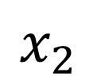

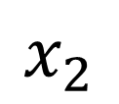
Multi-class classification
Binary classification
Multiclass classification
$$x_{2}$$
$$x_{2}$$
$$x_{1}$$
$$x_{1}$$

Slide 56










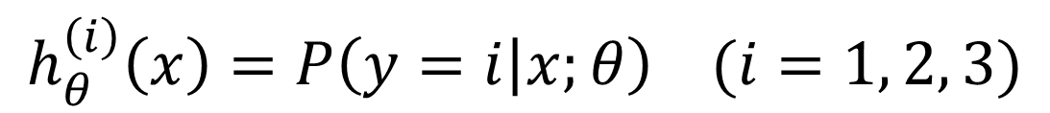

One-vs-all (one-vs-rest)
$$x_{2}$$
$$h_{θ}^{\left(1\right)}\left(x\right)$$
$$x_{1}$$
$$x_{2}$$
$$x_{2}$$
$$h_{θ}^{\left(2\right)}\left(x\right)$$
$$x_{1}$$
$$x_{1}$$
Class 1:
Class 2:
Class 3:
$$h_{θ}^{\left(3\right)}\left(x\right)$$
$$x_{2}$$
$$h_{θ}^{\left(i\right)}\left(x\right)=P\left(y=i | x;θ\right) (i=1, 2, 3)$$
$$x_{1}$$

Slide 57
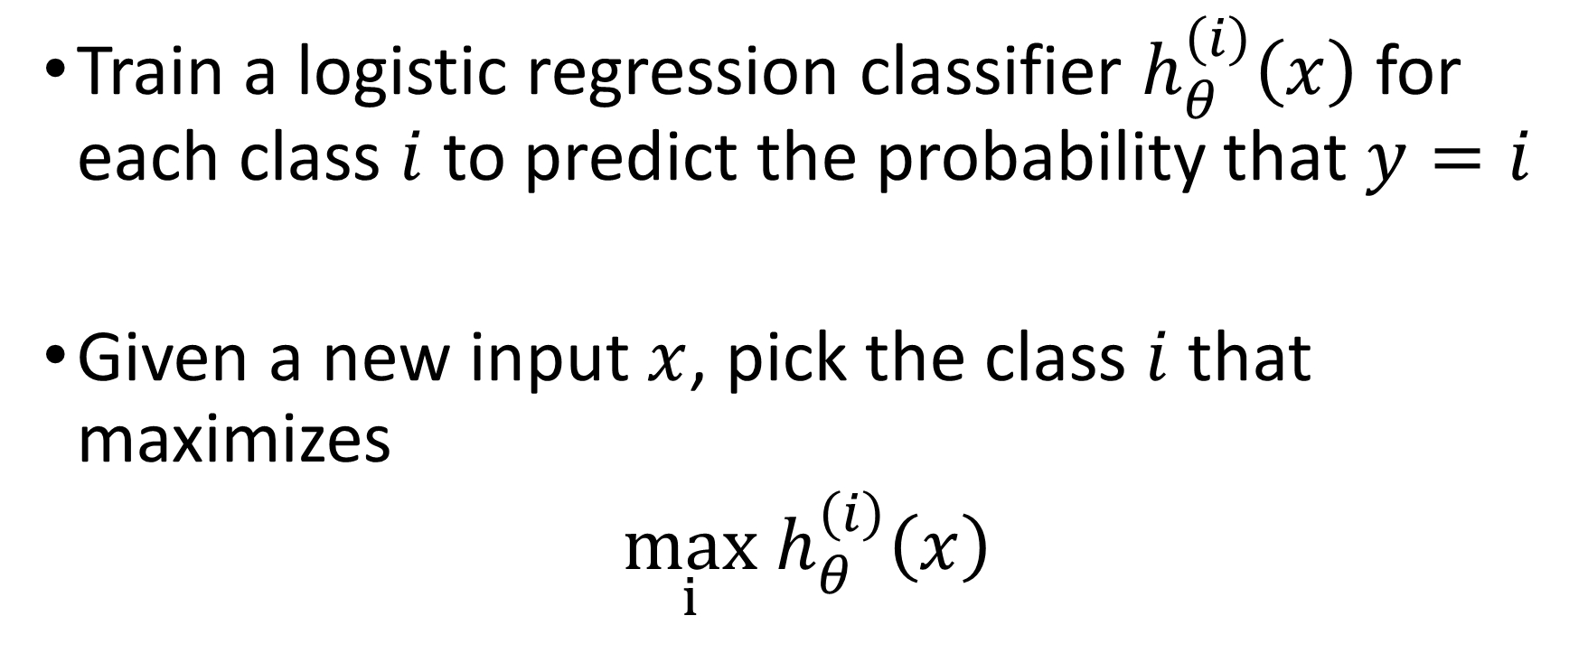
One-vs-all
Train a logistic regression classifier $h_{θ}^{\left(i\right)}\left(x\right)$ for each class $i$ to predict the probability that $y=i$
Given a new input $x$, pick the class $i$that maximizes
$\max_{i}$ $h_{θ}^{\left(i\right)}\left(x\right)$

Slide 58
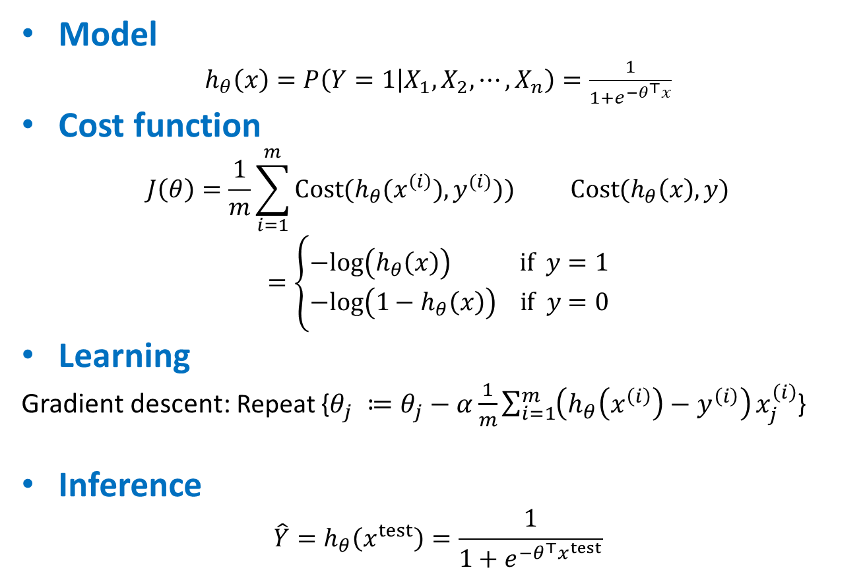
Logistic regression (Classification)
Model
$h_{θ}\left(x\right)=P\left(Y=1 | X_{1},X_{2}, ⋯, X_{n}\right)=\frac{1}{1+e^{−θ^{⊤}x}}$
Cost function
$$J\left(θ\right)=\frac{1}{m}\sum_{i=1}^{m}{Cost(h_{θ}(x^{\left(i\right)}),y^{(i)}))} Cost(h_{θ}\left(x\right),y)=\left\{\begin{aligned}−log\left(h_{θ}\left(x\right)\right) if y=1 \\ −log\left({1−h}_{θ}\left(x\right)\right) if y=0\end{aligned}\right.$$
Learning
Gradient descent: Repeat {$θ_{j} ≔θ_{j}−α\frac{1}{m}\sum_{i=1}^{m}{\left(h_{θ}\left(x^{\left(i\right)}\right)−y^{\left(i\right)}\right)}x_{j}^{\left(i\right)}$}
Inference
$$\hat{Y}=h_{θ}\left(x^{test}\right)=\frac{1}{1+e^{−θ^{⊤}x^{test}}}$$

Slide 59
Logistic Regression and Gaussian Naïve Bayes Classifier
Interestingly, the parametric form of P(Y|X) used by Logistic Regression is precisely the form implied by the assumptions of a Gaussian Naive Bayes classiﬁer.
Therefore, we can view Logistic Regression as a closely related alternative to GNB, though the two can produce different results in many cases

Slide 60
Parameter estimation of generic logistic regression
Logistic Regression holds in many problem settings beyond the GNB problem
General method required for estimating it in a more broad range of cases.
In many cases we may suspect the GNB assumptions are not perfectly satisﬁed.
We may wish to estimate the wi parameters directly from the data

Slide 61
References
Tom M. Mitchell Generative and discriminative classifiers: Naïve Bayes and Logistic Regression http://www.cs.cmu.edu/~tom/mlbook/NBayesLogReg.pdf
Andrew Ng, Michael Jordan On discriminative vs. generative classifiers: A comparison of logistic regression and naive bayes http://papers.nips.cc/paper/2020-on-discriminative-vs-generative-classifiers-a-comparison-of-logistic-regression-and-naive-bayes.pdf
https://see.stanford.edu/materials/aimlcs229/cs229-notes1.pdf

Slide 62
References
http://www.cs.cmu.edu/~tom/NewChapters.html
http://ai.stanford.edu/~ang/papers/nips01-discriminativegenerative.pdf
https://medium.com/@sangha_deb/naive-bayes-vs-logistic-regression-a319b07a5d4c
https://www.youtube.com/watch?v=-la3q9d7AKQ
http://www.datasciencesmachinelearning.com/2018/11/handling-outliers-in-python.html
l

Slide 63
Self Learning

Slide 64
Naïve Bayes Generative Model
Naïve Bayes classifier uses likelihood and prior probability to calculate conditional probability of the class
Likelihood is based on joint probability, which is the core principle of probabilistic generative model
Naïve Bayes simplifies the calculation of likelihood by the assumption of conditional independence among input parameters
Each parameter’s likelihood is determined using joint probability of the input parameter and the output label

Slide 65
Naïve Bayes – Advantages
Algorithm is simple to implement and fast
If conditional independence holds, it will converge quickly than other methods
Even in cases where conditional independence doesn’t hold, its results are quite acceptable
Needs less training data (due to conditional independence assumption)
Highly scalable, scales linearly with the number of predictors and data points
Can be used for both binary and multi-class classification problems
Handles continuous and discrete data
Not sensitive to irrelevant features
Doesn’t overfit the data due to small model size (compared to other algorithms like Random Forest)
Handles missing values well

Slide 66
Naïve Bayes – When to use
When the training data is small
When the features are conditionally independent (mostly)
When we have large number of features with minimal data set
Ex: Text classification

Slide 67
How does logistic regression handle missing values?
Replace missing values with column averages (i.e. replace missing values in feature 1 with the average for feature 1).
Replace missing values with column medians.
Impute missing values using the other features.
Remove records that are missing features.
Use a machine learning technique that uses classification trees, e.g. Decision tree

Slide 68
Class Imbalance Problem
Find needle in haystack
Lots of classification problems where the classes are skewed (more records from one class than another)
Credit card fraud
Intrusion detection
Defective products in manufacturing assembly line

Slide 69
Approaches to solve Class imbalance problem
Up-sample minority class
randomly duplicating observations from a minority class
Down-sample majority class
removing random observations.
Generate Synthetic Samples
new samples based on the distances between the point and its nearest neighbors
Change the performance metric
Use Recall, Precision or ROC curves instead of accuracy
Try different algorithms
Some algorithms as Support Vector Machines and Tree-Based algorithms are better to work with imbalanced classes.

